Slide 1

IoC and DI with Ninject
3 – Dependency Inversion

Slide 2
What is Dependency Injection
A type of IoC where we move the creation and binding of a dependency to outside of a class that depends upon it
Different types
Constructor
Property / setter
Interface

Slide 3





Where do they come from?
I’m still dependent on the fact that I have to create objects

Slide 4


The injection process
The injector knows how to resolve dependencies
It injects objects into another objecft

Slide 5
Constructor Injection
Objects are passed into the constructor
Now don’t need to explicitly create in the constructor
But:
Can’t use class before things are injected
Bad for GUI’s and MVVM, or with async data

Slide 6
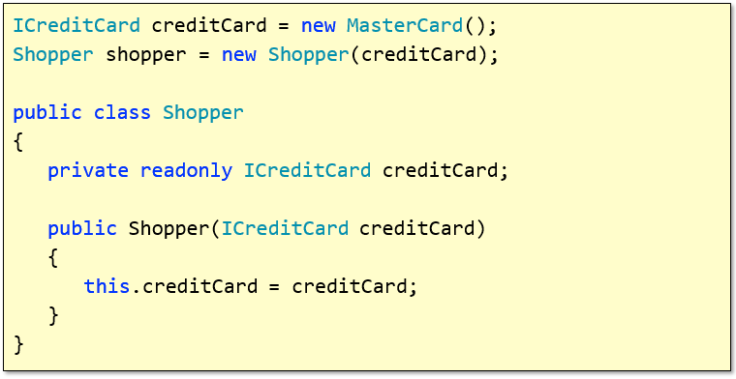
Basic example

Slide 7
Setter Injection
Objects set by injector via property setters
Objects can be used before injection
But need to know dependencies may not be resolved

Slide 8
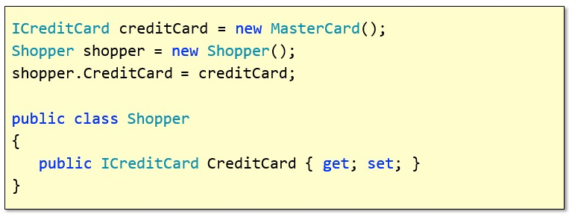
Setter injection example

Slide 9
Interface Injection
Dependent class implements an Injection interface
Injector uses this interface to set the dependency

Slide 10
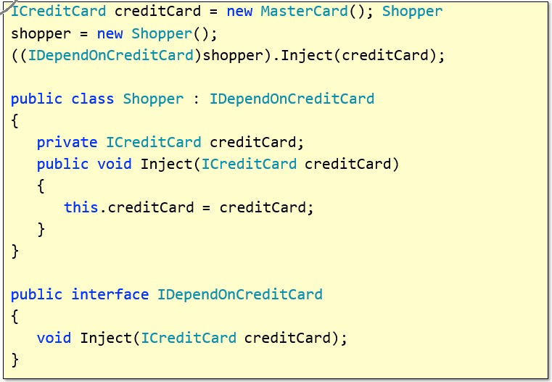
Interface Injection Example

Slide 11
Caution
Leaks internal implementation
Prevents deferred creation
Large object graphs
Sometimes hard to know where objects came from
Great for mocks though
Easier unit testing

Slide 12
Summary
Dependency injection lets us not need to know where objects come from
We specify what objects we need by interface specification
An external force then gives us objects
These are containers

